Slide 1
Affective computing
CS616

Slide 2
Overview of this module
Interesting research questions
That I care about
Sentiment analysis
Recommended reading: Pang & Lee (2008) Opinion mining and sentiment analysis
Affect, emotion and trait determination
BCI
Emotive responding
Gamification
Reinforcement learning
Explore-exploit dilemma
Artificial curiosity
Alternative models of preference learning

Slide 3
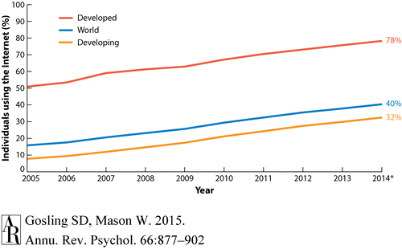
Internet access is near universal

Slide 4
Potential in behavior research
Scale
Efficiency
Granularity
Ecological validity

Slide 5
Psychology of the internet
Category 1

Slide 6
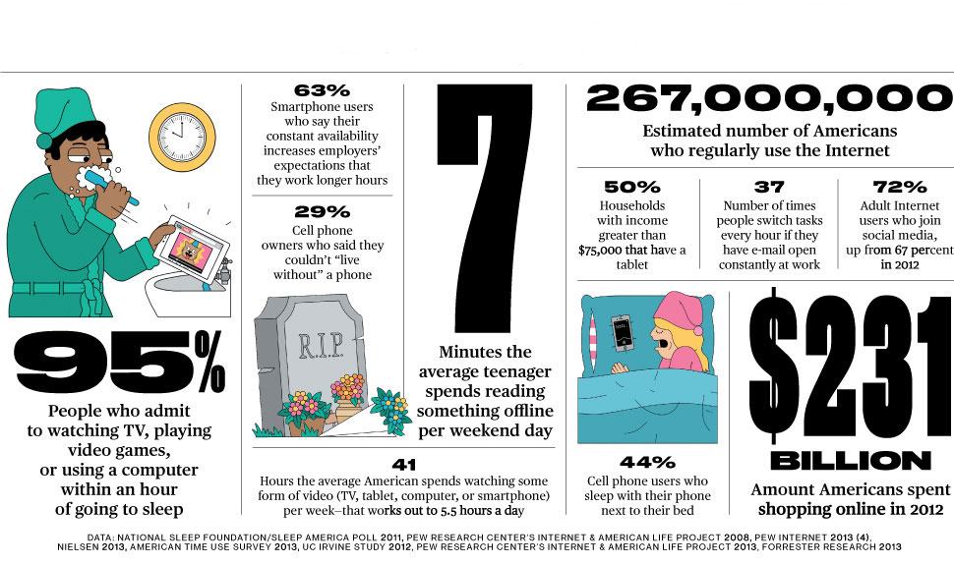
Common research themes

Slide 7

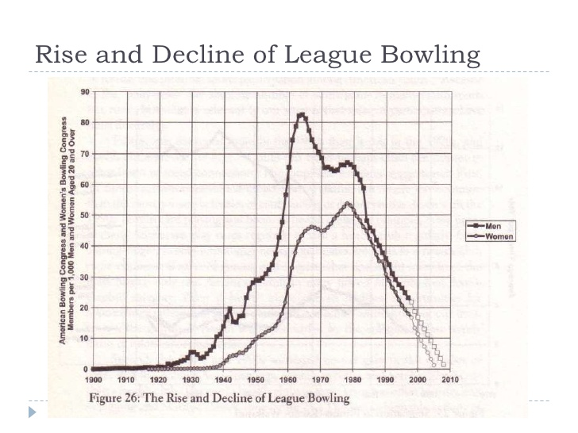
Important questions

Slide 8

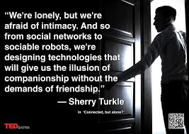
Important questions

Slide 9
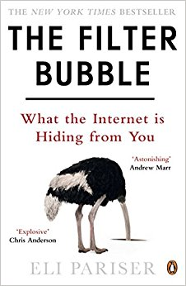
Important questions
Popularity
Ranking
Click data
Relevance

Slide 10

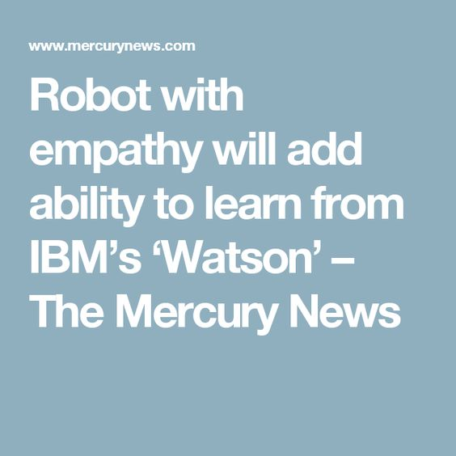
No convincing data
Hard to quantify central constructs
Hard to attribute causality
Hard to collect representative data
But answering these questions is crucial!

Slide 11
Psychology via the internet
Category 2

Slide 12
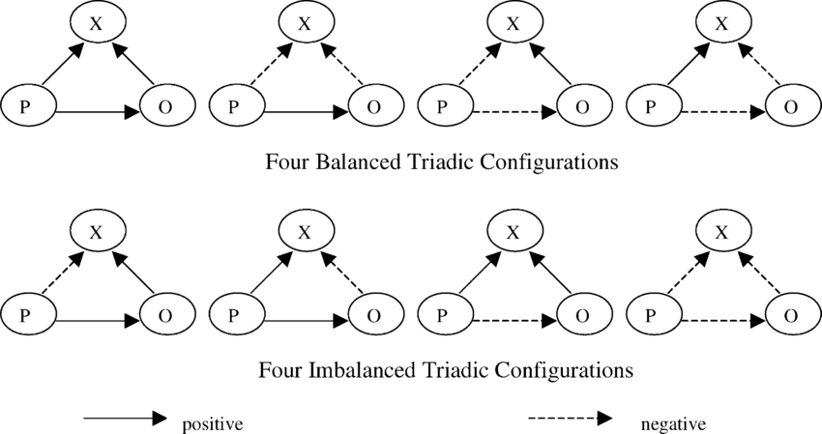
Triadic relationship interactions
Convincing evidence this account holds for reciprocal web relationships (Leskovec, 2010)

Slide 13
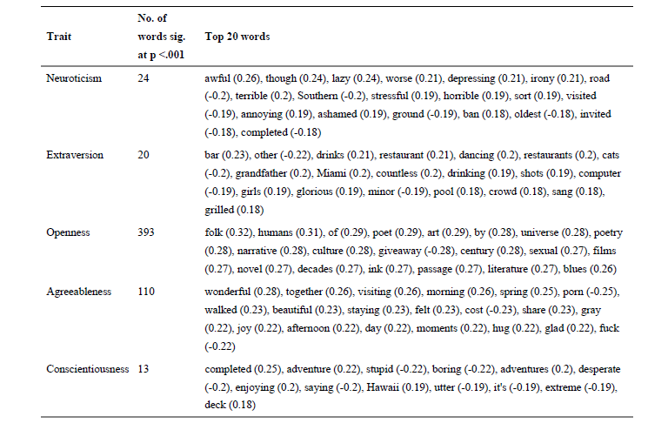
Word-trait associations
(Yarkoni, 2010)

Slide 14
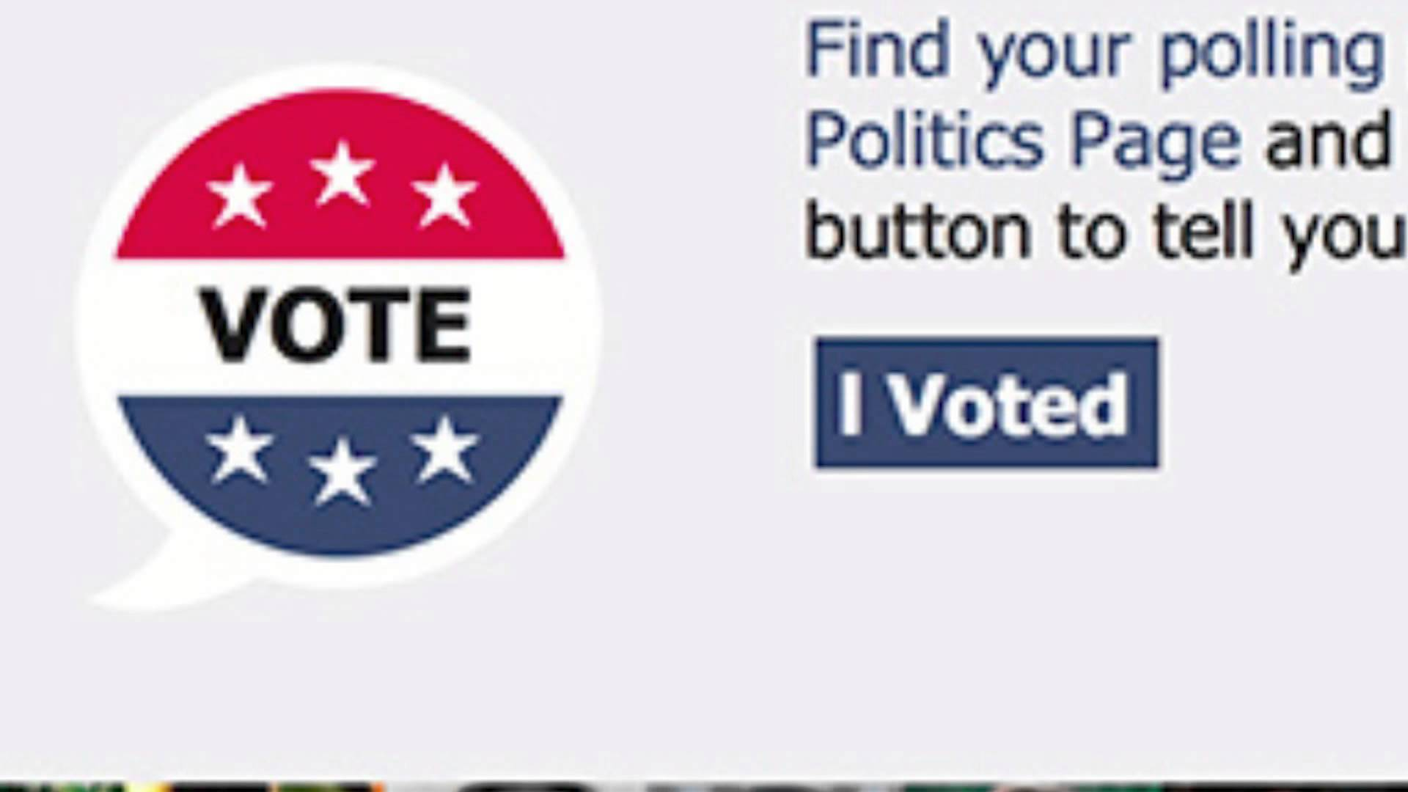
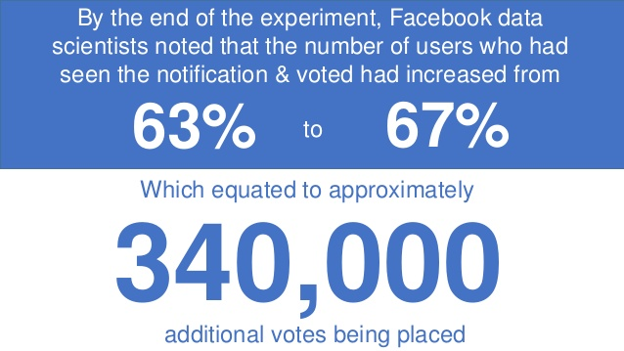
Social contagion

Slide 15
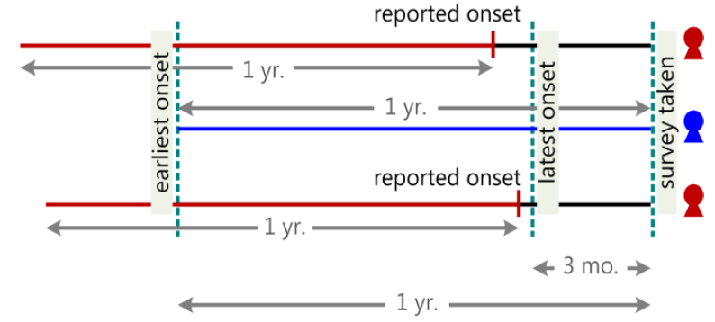
Track depression via Twitter
~ 500 participants

Slide 16
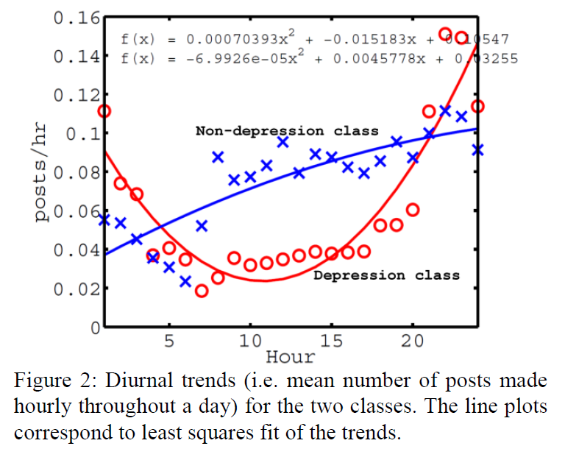
Diurnal patterns

Slide 17
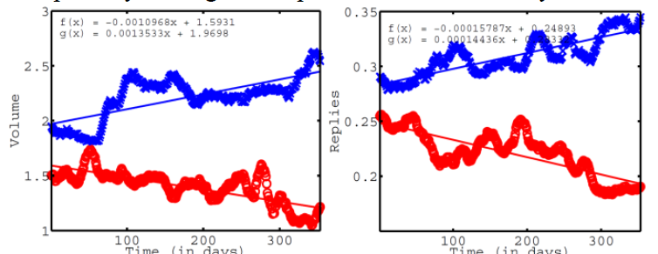
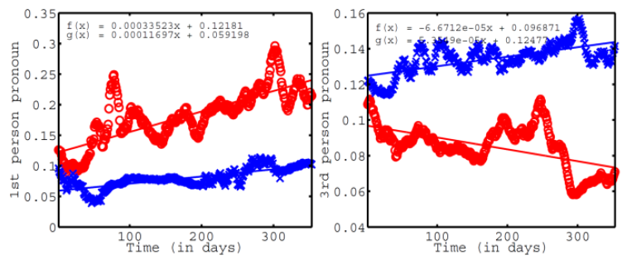
Evolution of situation

Slide 18
Common methodology
Surveys
Personality tests, commonly the Big Five
Simple statistics on digital data

